Slide 1
Principle Component Analysis
a bold adventure

Slide 2
Problem
Curse of dimensionality

Slide 3
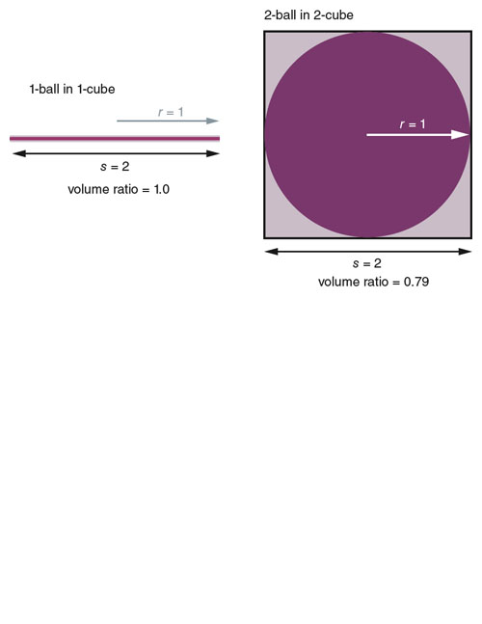
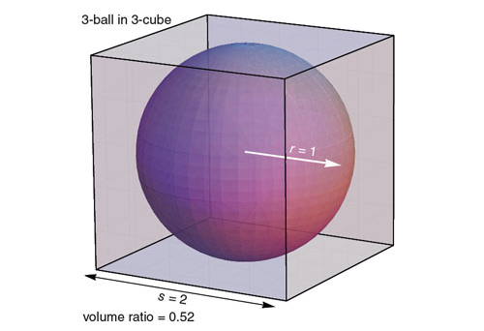
Problem
Curse of dimensionality

Slide 4
Problem
Curse of dimensionality
as features , so does:

Slide 5
Problem
Curse of dimensionality
as features , so does:
difficulty partitioning space

Slide 6
Problem
Curse of dimensionality
as features , so does:
difficulty partitioning space
test error from noisy features (swamping)

Slide 7
Problem
Curse of dimensionality
as features , so does:
difficulty partitioning space
test error from noisy features (swamping)
data snooping bias

Slide 8
Problem
Curse of dimensionality
as features , so does:
difficulty partitioning space
test error from noisy features (swamping)
data snooping bias
time to search space

Slide 9
Problem
Curse of dimensionality
High-dimensional data

Slide 10
Problem
Curse of dimensionality
High-dimensional data
Also affects lower-dimensional data

Slide 11
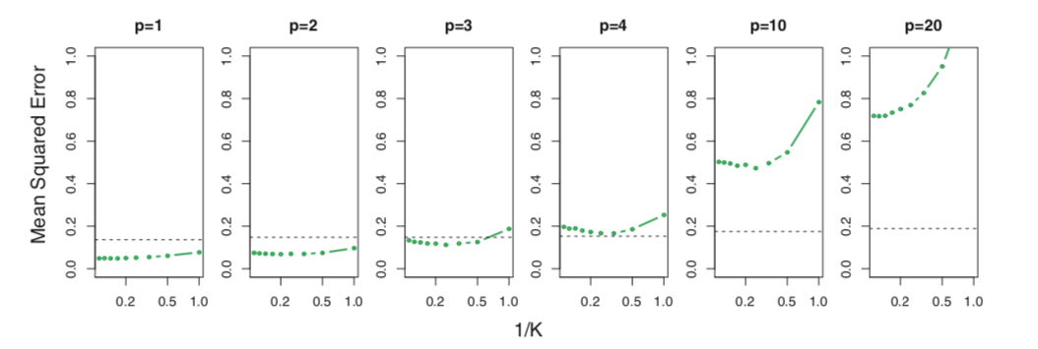
Problem
KNN and OLS test MSE with first cubed feature determining target variable (others random)
Intro to Statistical Learning with Applications in R, pg 109

Slide 12
Solutions

Slide 13
Solutions
Domain knowledge

Slide 14
Solutions
Domain knowledge
Make assumptions about data

Slide 15
Solutions
Dimensionality reduction!

Slide 16
Solutions
Dimensionality reduction!
Represent the information in the data with fewer dimensions

Slide 17
Solutions
Dimensionality reduction!
Represent the information in the data with fewer dimensions
Inevitable information loss

Slide 18
Solutions
Dimensionality reduction!
Represent the information in the data with fewer dimensions
Inevitable information loss
But info loss < error reduction through reducing dimensions

Slide 19
Solutions
Dimensionality reduction!
Represent the information in the data with fewer dimensions
Inevitable information loss
But info loss < error reduction through reducing dimensions (usually)

Slide 20
Solutions
Dimensionality reduction!
Represent the information in the data with fewer dimensions
Inevitable information loss
But info loss < error reduction through reducing dimensions (usually) (hopefully)

Slide 21
Solutions
How?

Slide 22
Solutions
How? Represent data in lower dimensional space

Slide 23
Solutions
How? Represent data in lower dimensional space
Feature selection

Slide 24
Solutions
How? Represent data in lower dimensional space
Feature selection
Feature extraction

Slide 25
Solutions
How? Represent data in lower dimensional space
Feature selection
Feature extraction
Agglomerate data in larger units

Slide 26
Solutions
How? Represent data in lower dimensional space
Feature selection
Feature extraction
Agglomerate data in larger units
Project data into other dimensions

Slide 27
Principal Component Analysis

Slide 28
Principal Component Analysis
Broadly:

Slide 29
Principal Component Analysis
Broadly:
Method of projecting data into new dimensions, one dimension at a time

Slide 30
Principal Component Analysis
Broadly:
Method of projecting data into new dimensions, one dimension at a time
Result is a series of weights that are multiplied by the original features

Slide 31
Principal Component Analysis
Broadly:
Method of projecting data into new dimensions, one dimension at a time
Result is a series of weights that are multiplied by the original features
These weights transform the data into a series of new features, new << original

Slide 32
Principal Component Analysis
Broadly:
1st dimension is direction of greatest variability
2nd dimension second-greatest variability, etc. subject to constraint they’re all
If data transformed into every new dimension, all the variability from original data will be represented in new space

Slide 33
How?
Center the points
Compute covariance matrix
Find eigenvectors and eigenvalues
Pick M eigenvectors (<original D features) with highest eigenvalues
Project data through the M eigenvectors

Slide 34
Caveats
Make sure to normalize each dimension to zero mean and unit variance before performing PCA
Only picks up linear variation
Extremely sensitive to large values

